Slide 1

Estimating Obesity Levels Based on Eating Habits and Physical Activity
Based on eating habits and physical activity dataset from countries Mexico, Peru and Columbia
https://icon-library.com/images/obesity-icon/obesity-icon-11.jpg
Team 4 - LaQuita Palmer, Nickson Njau, Symia Woodson, and Wanda Knight
Notes:
Team 4 chose a dataset on Estimating Obesity Levels Based on Eating Habits and Physical Activity. The demographics for this dataset are men and women from the countries Mexico, Peru and Columbia. According to World Health Organization “overweight and obesity are major risk factors for a number of chronic diseases, including cardiovascular diseases such as heart disease and stroke, which are the leading causes of death worldwide”. Predicting Obesity is important because it can help identify and address risk factors early, which can lead to prevention and reduce the risk of chronic diseases.

Slide 2
Project Overview
Using machine learning to predict obesity levels based on individuals' eating habits and physical activity from a dataset
Developed an accurate model
Provide valuable insights into the factors contributing to obesity, potentially aiding in public health initiatives and personalized health recommendations

Slide 3
Overview of the Project Phases
Steps taken for the Overview of the Project Phases:
Data set pick
Data Processing
Model Development
Hyper Parameter Tuning
Results

Slide 4
Data Set Picking
For the data set, we utilized the "Estimation of Obesity Levels Based on Eating Habits and Physical Condition" dataset from the UCI Machine Learning Repository
This data set contained 2,111 records with various features related to eating habits, physical condition, and demographic information

Slide 5
Data Processing
Extraction and Cleaning
Extraction and cleaning processes:
Dropped all the null values in the data set by utilizing the dropna() function
Encoding the values using a str_to_int dictionary and the replace() function
Using Scikit-learn, we split the data into training and testing sets
Saved the cleaned up data into a dataframe for further analysis
Notes:
Sigh kit

Slide 6
Data Processing
Exploratory Data Analysis
We conducted initial data exploration to understand:
Feature distribution
Correlation between variables
Class balance in the target variable (Obesity levels)
Notes:
Pass the next set of slide to Symia Woodson

Slide 7
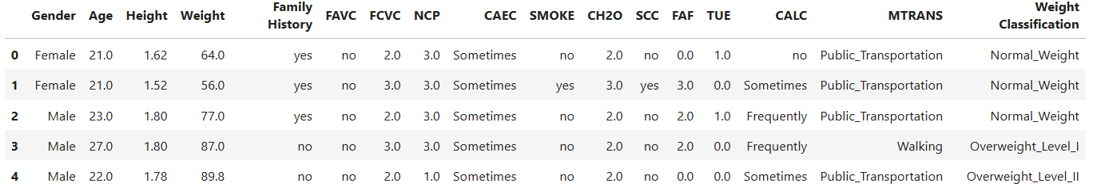
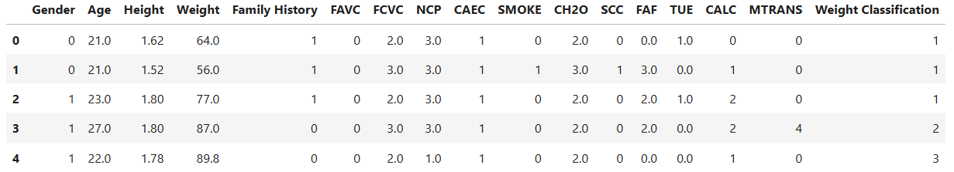
Encoded

Slide 8
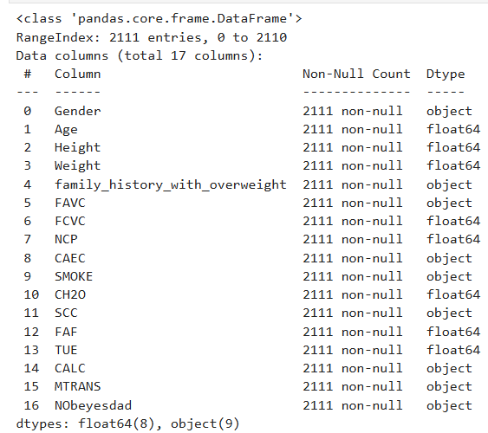
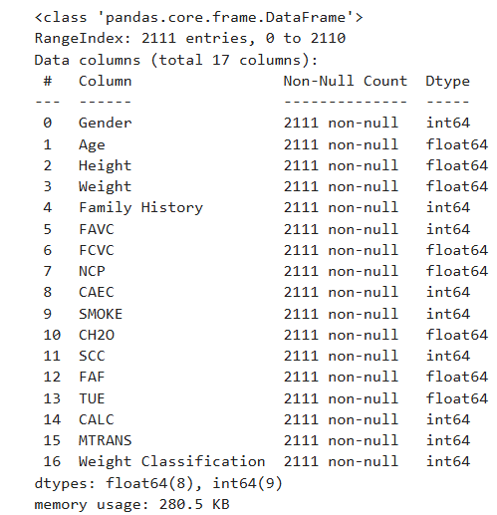
Encoded data-types

Slide 9
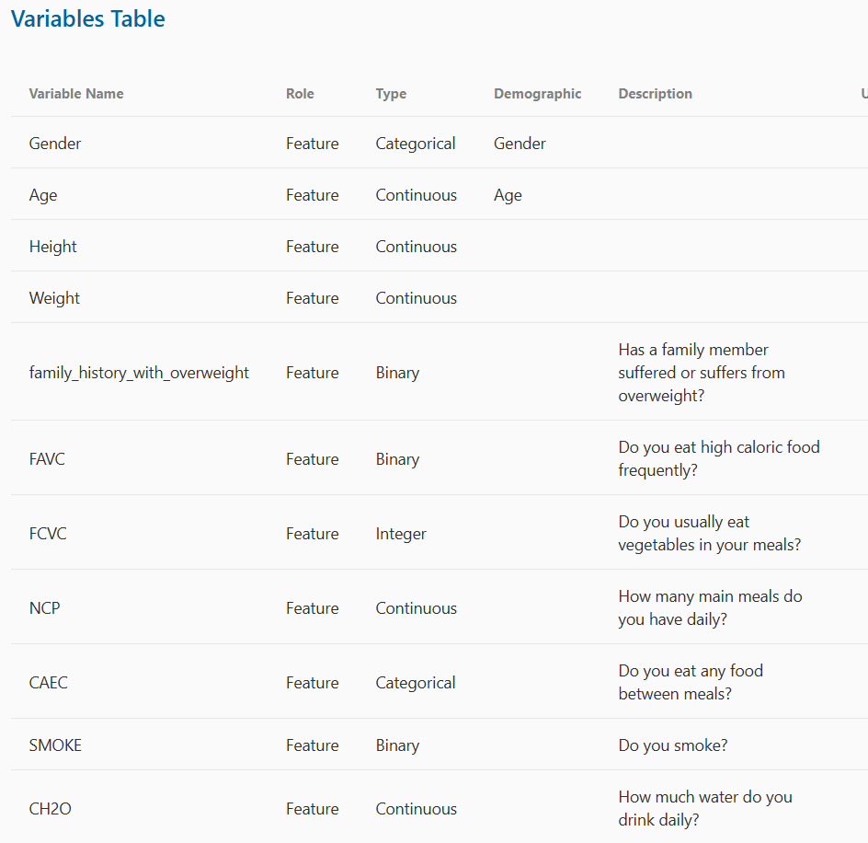
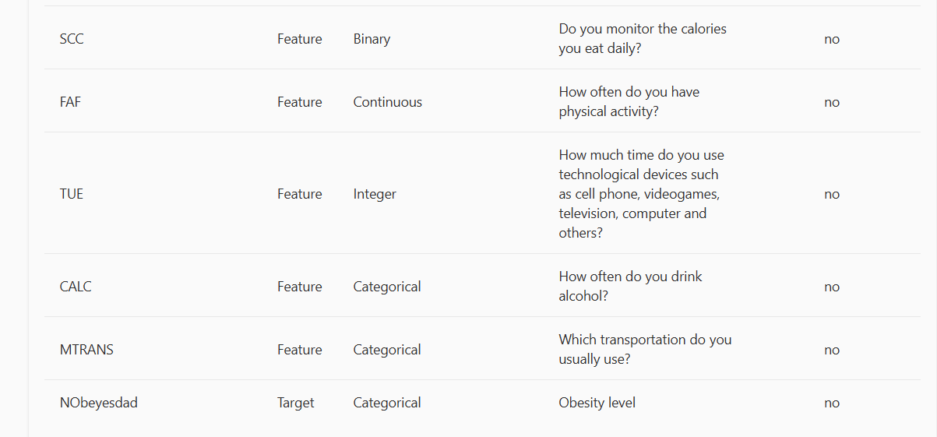
Features

Slide 10
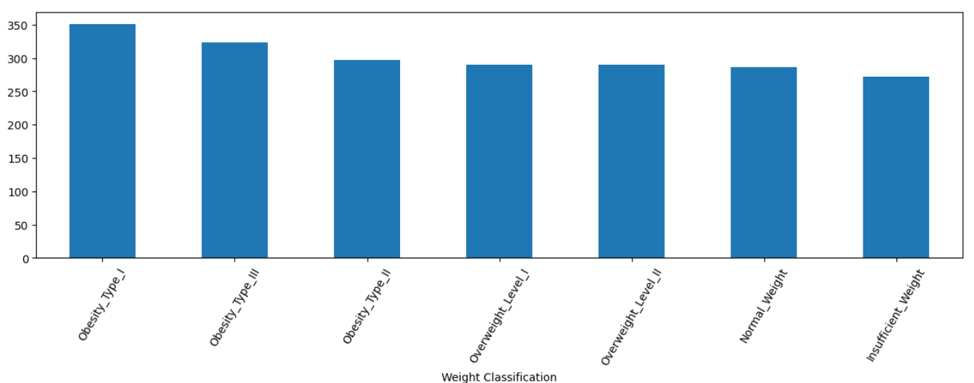
Value count of each weight classification

Slide 11
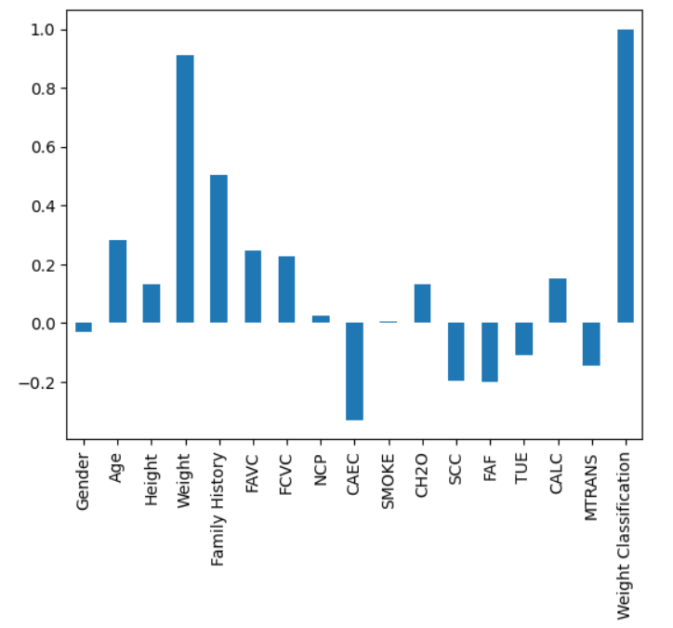
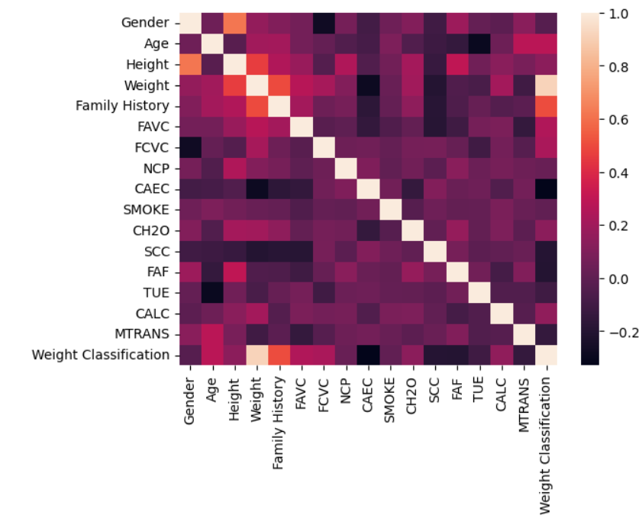
Correlation Bar Chart and Heatmap

Slide 12
Model Development
Training and Evaluation
Initialized all the models we wanted to train and evaluate.
Our target was to achieve a classification accuracy of at least 75% or an R-Squared value of 0.801

Slide 13
Model Development
Models Trained
Logistic Regression
Support Vector Machines (SVM)
Random Forests
K-Nearest Neighbors (KNN)
Gradient Boosting
Adaptive Boosting
Decision Trees
Extra Trees

Slide 14
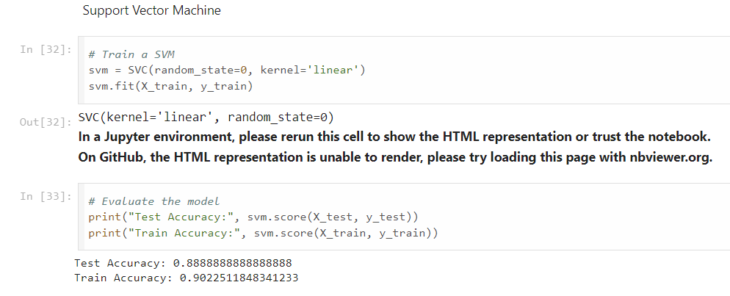
Model Development
Support Vector Machines (SVM)
88% accuracy level during testing

Slide 15
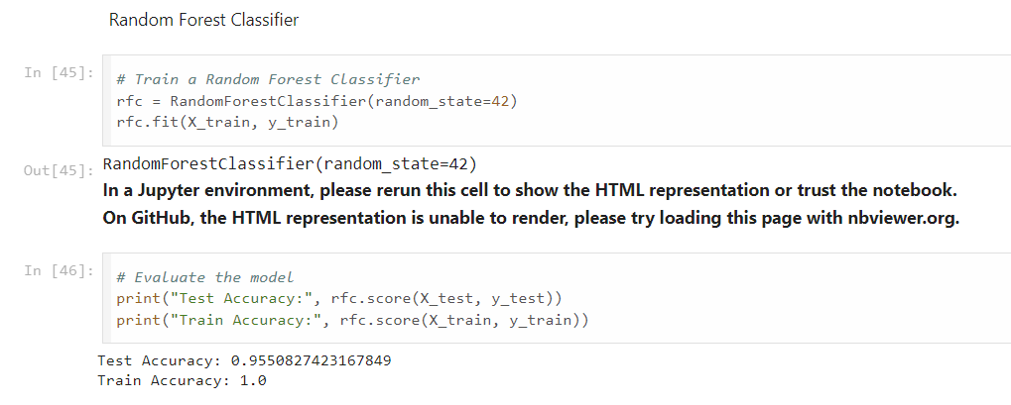
Model Development
Random Forests
95% accuracy level during testing

Slide 16
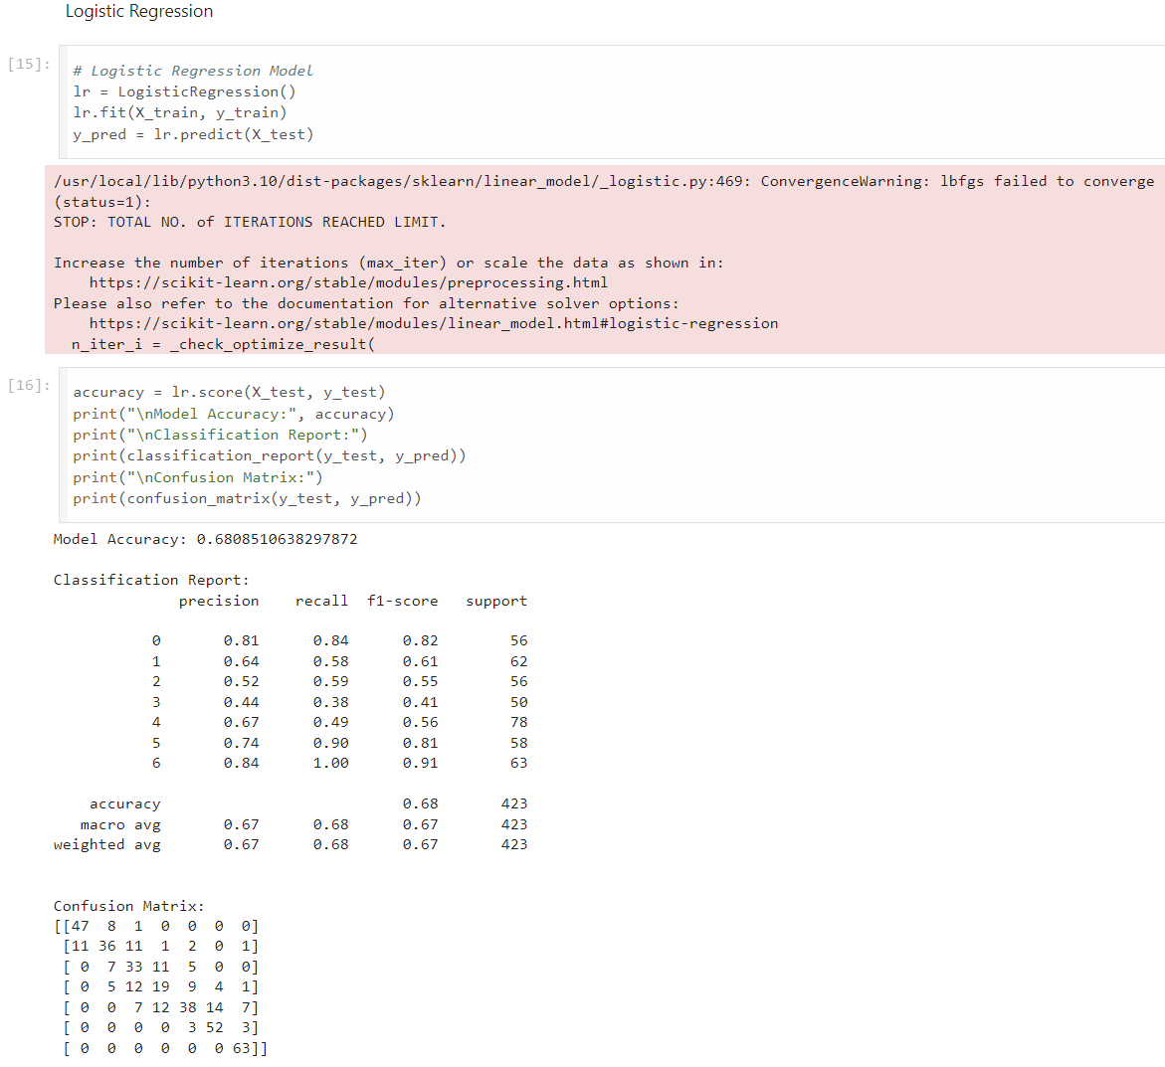
Model Development
Logistic Regression
68% accuracy level for Logistic Regression model

Slide 17
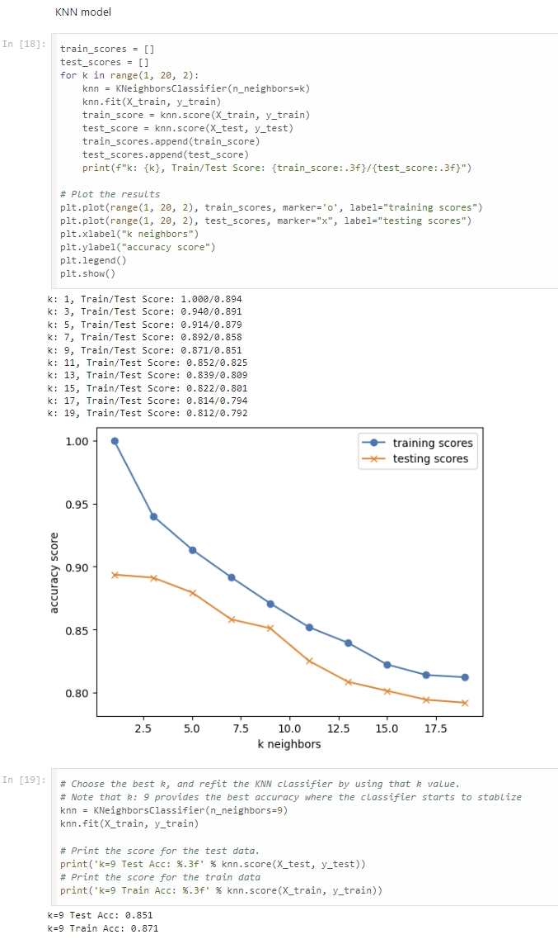
Model Development
K-Nearest Neighbors (KNN)
85% accuracy level during testing

Slide 18
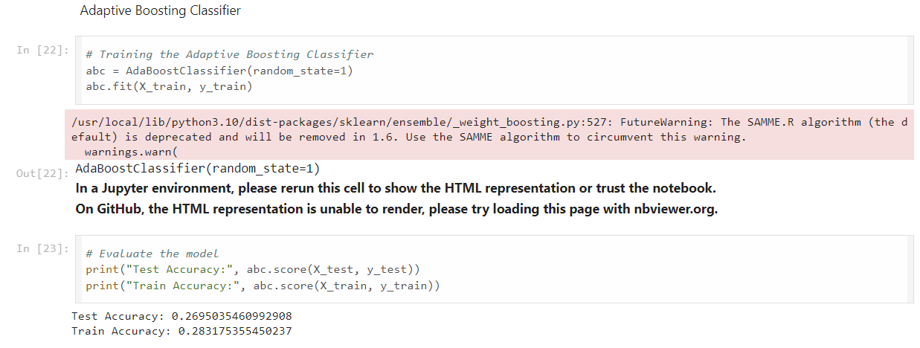
Model Development
Adaptive Boosting
26.9% accuracy level during testing

Slide 19
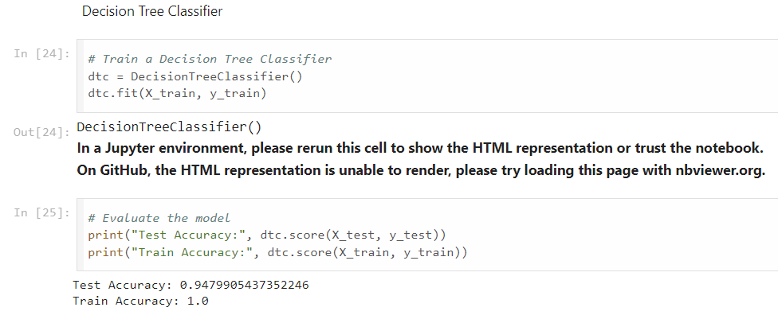
Model Development
Decision Trees Model
94.7% accuracy level during testing

Slide 20
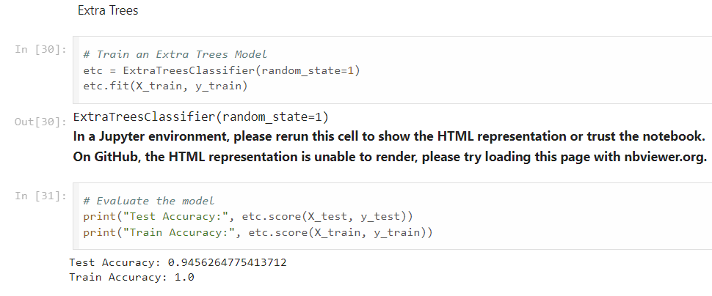
Model Development
Extra Trees Model
94.5% accuracy level during testing

Slide 21
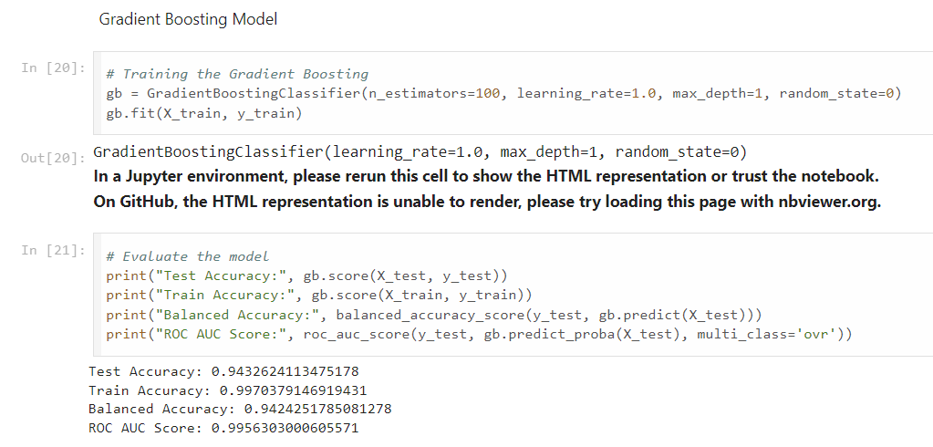
Model Development
Gradient Boosting Model
94.3% accuracy level during testing

Slide 22
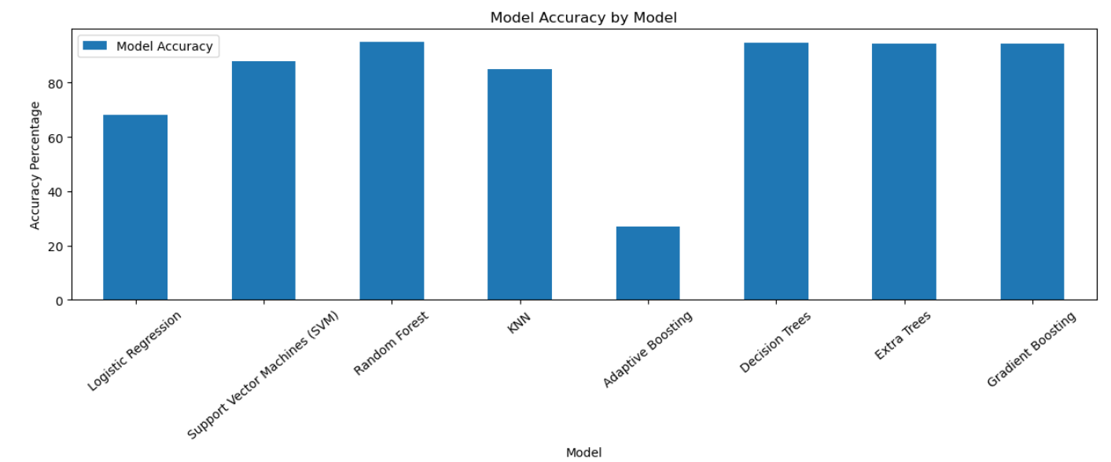
Model Accuracy
Random Forest was chosen

Slide 23
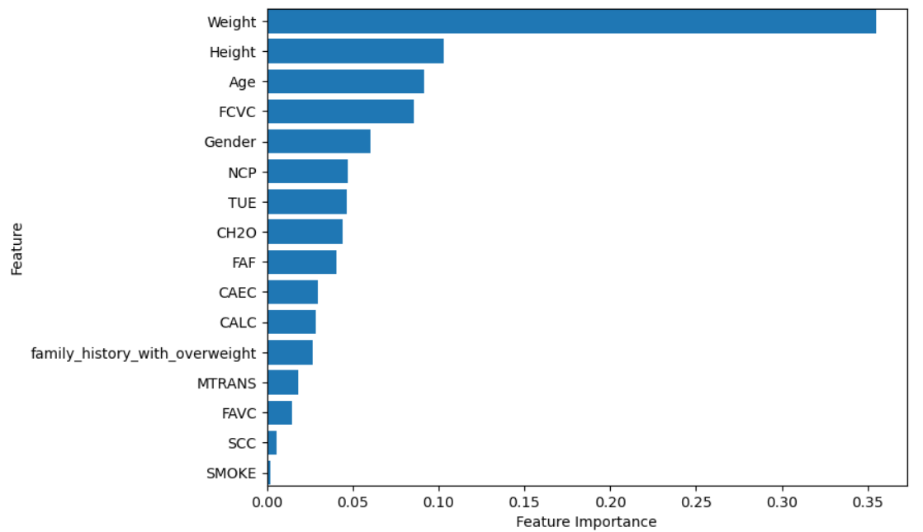
Random Forest feature importance
Notes:
Breakdown by the most important features: gender and height. The colors are by end category. Need to add legend and make the information side by side

Slide 24
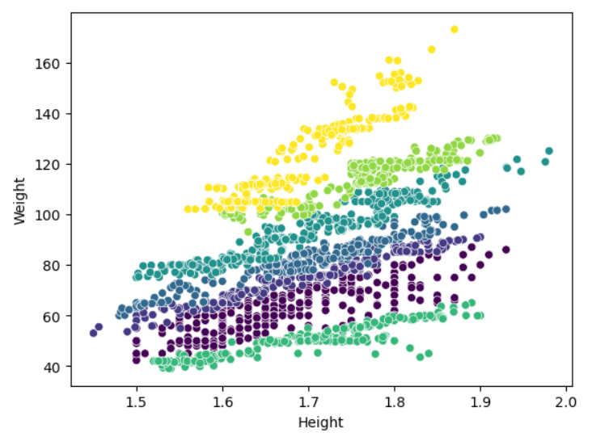
Random Feature scatterplot of weight and height with the end being the classification
Weight Classification
Obesity_Type_I 351
Obesity_Type_III 324
Obesity_Type_II 297
Overweight_Level_I 290
Overweight_Level_II 290
Normal_Weight 287
Insufficient_Weight 272
Notes:
Reduce the number or outputs. Gets the model more accurate. Add a legend for easier

Slide 25
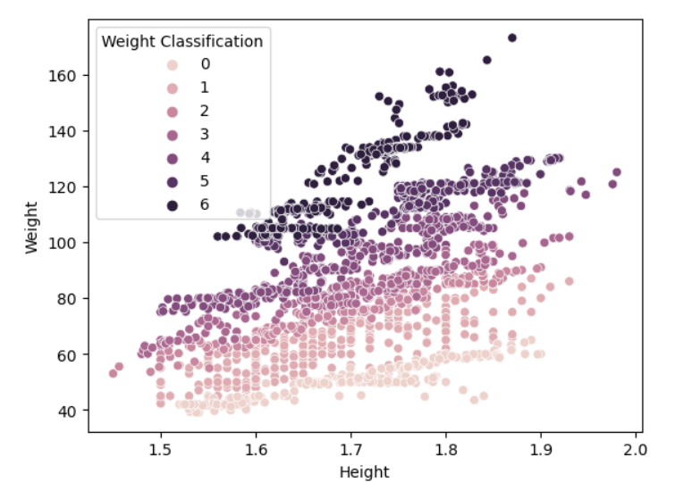
Random Feature scatterplot of weight and height with the end being the classification
Weight Classification
Insufficient_Weight : 0,
Normal_Weight: 1,
Overweight_Level_I: 2,
Overweight_Level_II: 3,
Obesity_Type_I: 4,
Obesity_Type_II': 5,
Obesity_Type_III: 6,

Slide 26
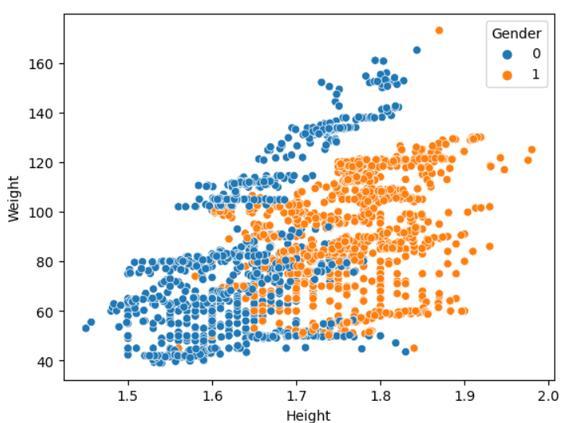
Random Feature scatterplot of weight and height with the end being the classification
Women: blue
Men: orange

Slide 27
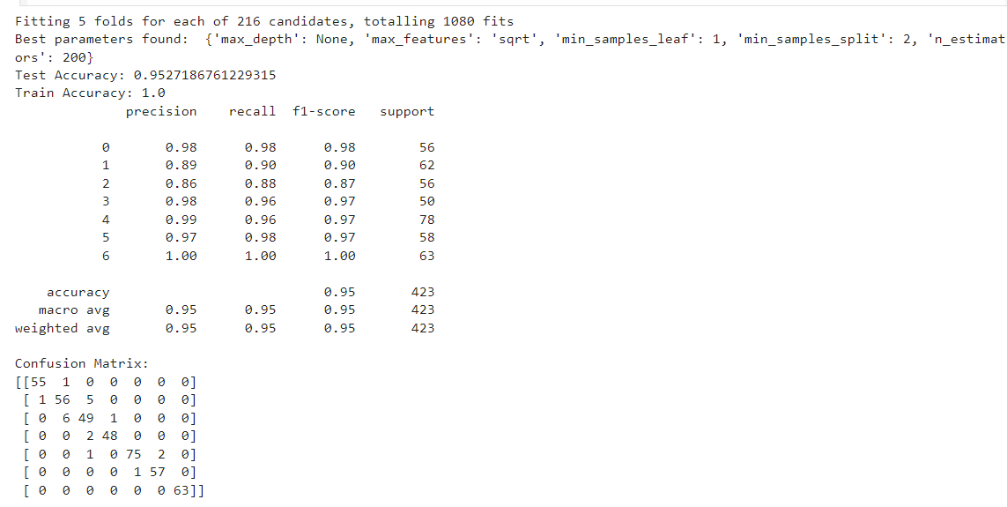
Hyperparameter Tuning (Random Forests)
Randomized Search CV
Using the module, we were able to obtain and use the best parameters to create the best model
Accuracy: 95.2%

Slide 28
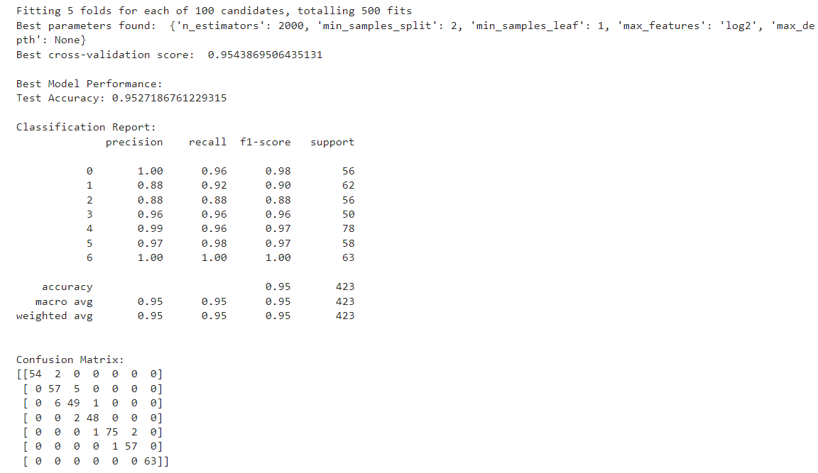
Hyperparameter Tuning (Random Forests)
GridSearch CV
Using the module, we were able to obtain and use the best parameters to create the best model
Accuracy: 95.2%

Slide 29
Results
Random Forests Model with Tuned parameters achieved the best performance.
Key metrics:
Accuracy: 95%
Precision: 96%
Recall: 97%
F1-Score: 98%

Slide 30
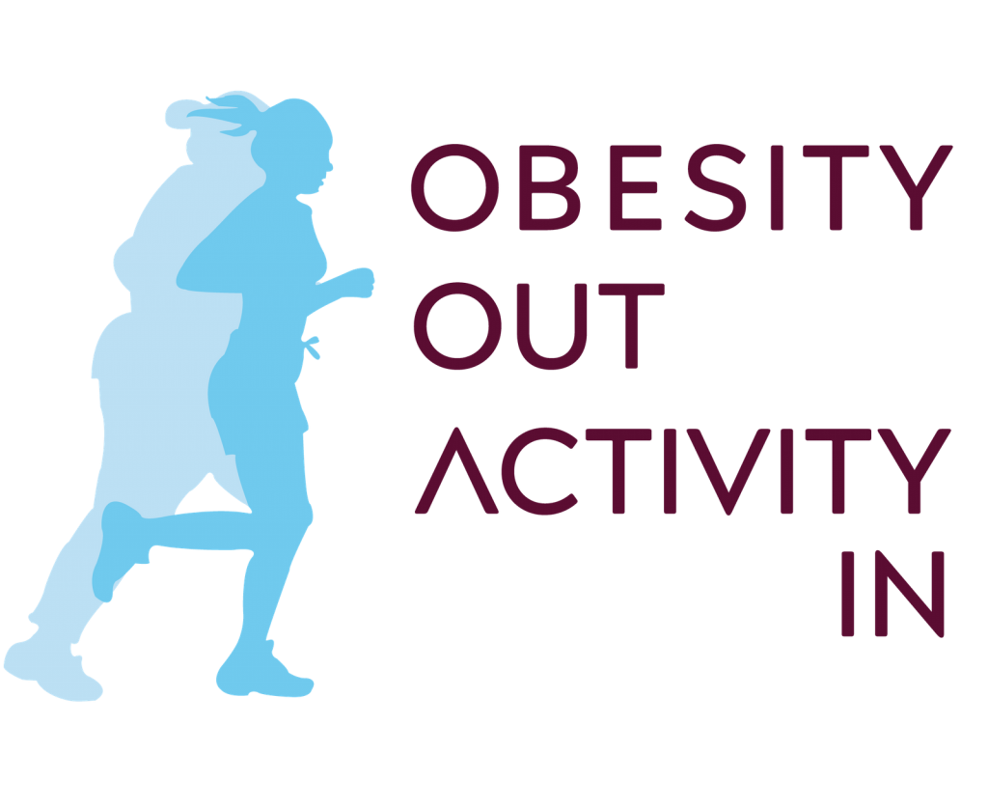
Citations
"Estimation of Obesity Levels Based On Eating Habits and Physical Condition ." UCI Machine Learning Repository, 2019, https://doi.org/10.24432/C5H31Z.
https://worlsest.org/Obesity-out-Activity-in-logo-colourful-1-1024x838

